Slide 1
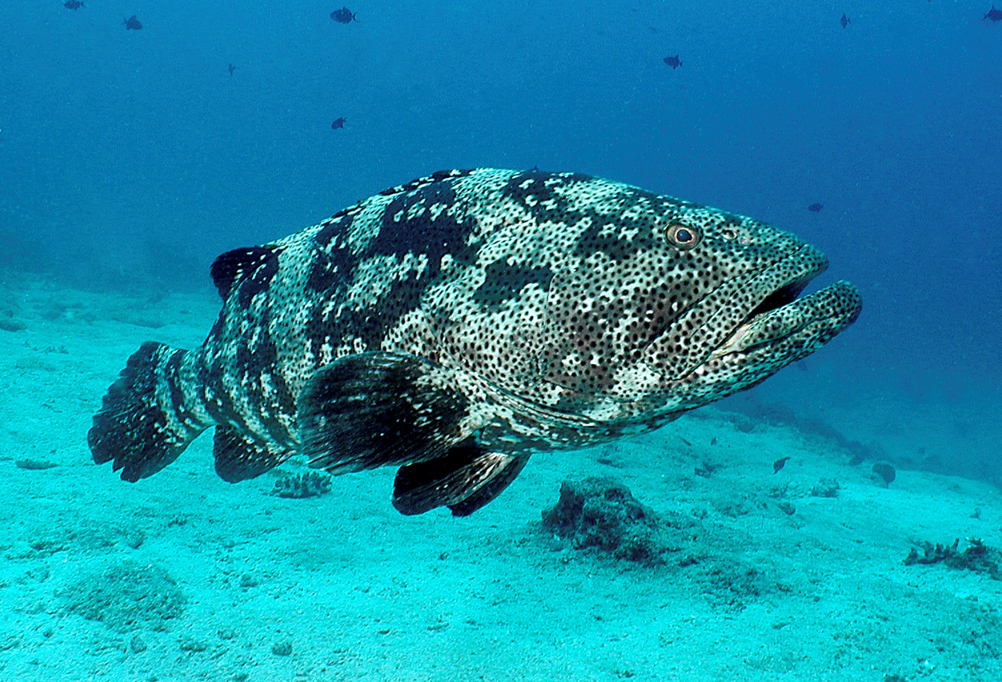
Monitoring by NGOs for marine conservation management
– examples from Indonesia
“The big Grouper in the room”

Slide 2
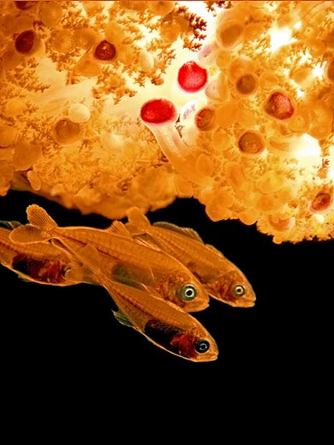
Disclaimer
This is a conversation
General, no platitudes
Some illustrations, no solid data set
More questions than answers

Slide 3
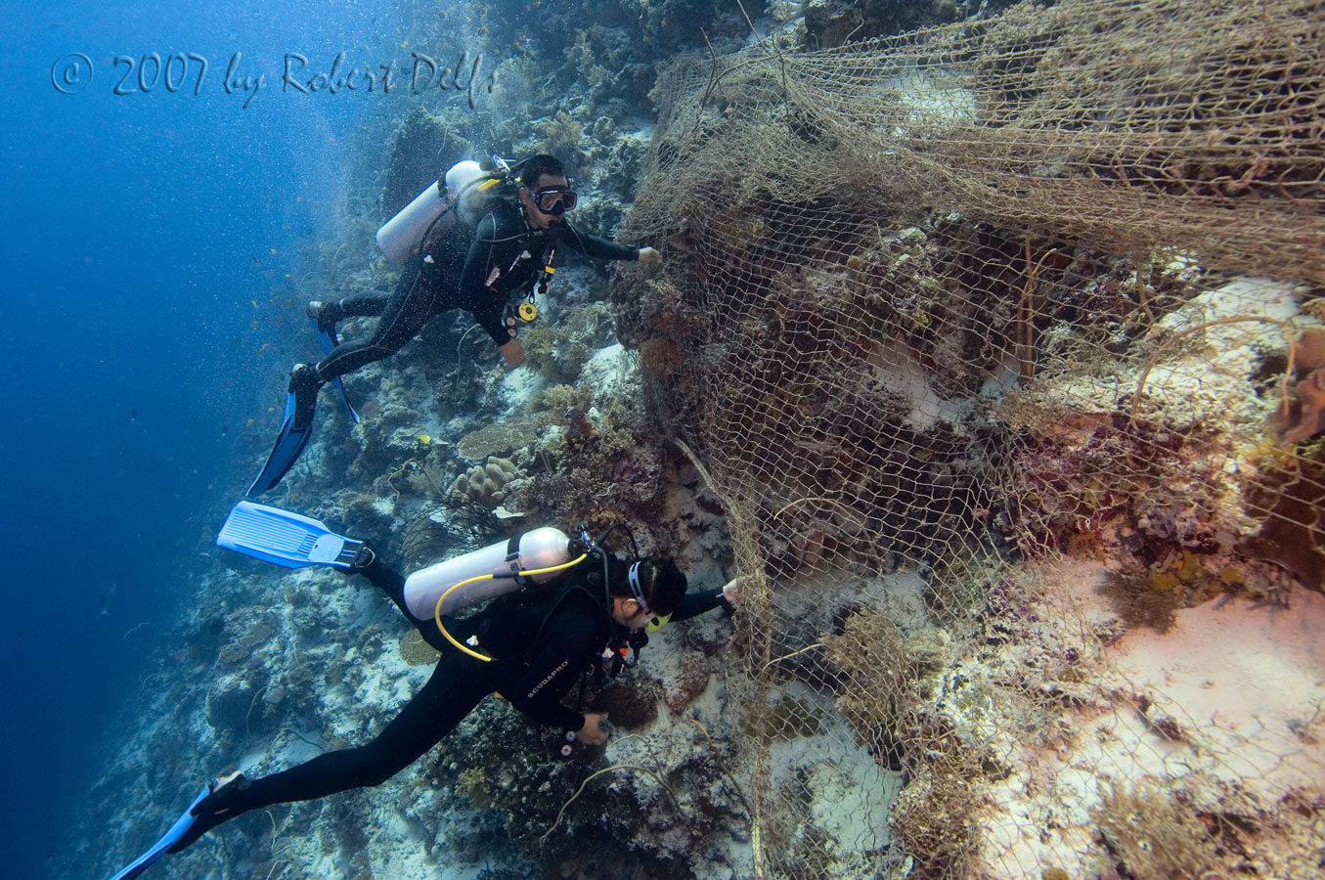
Measuring for marine management
Different objectives – different approaches
  ambient monitoring
  management assessment
  performance measurement
  impact evaluation
  systematic review
  (Mascia et al submitted)
Conservation Science – understanding how natural world works ~ understanding how action impacts on nature – monitoring for adaptive management

Slide 4
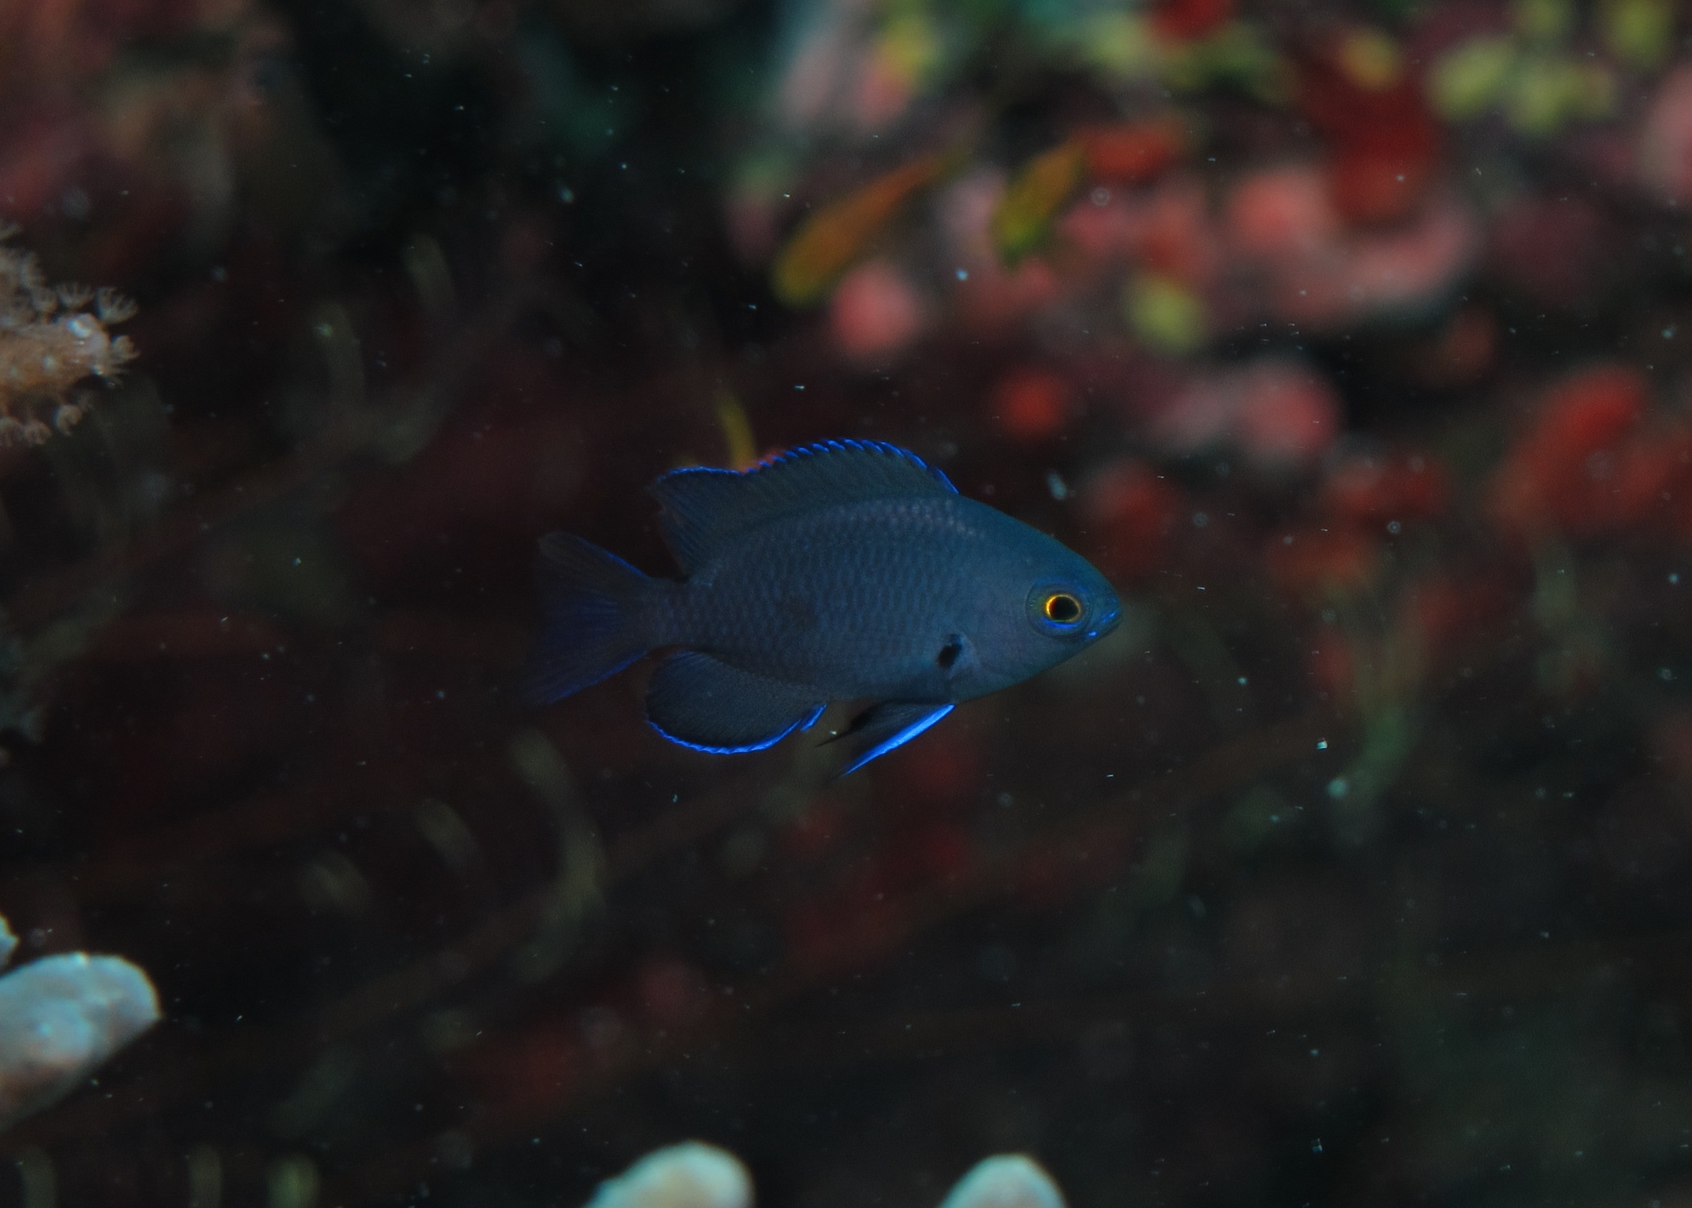
Some common observations
Political relevance – willingness to act – who moved my cheese?
  Challenge the methods, the application in different setting, the motives
  High turn over decision makers: repeat arguments
  Factors outside influence mess up trend: climate change
  Defeatism over size of the problem
Infrastructure and resources – never enough
  Objective: change behavior but monitoring: ecosystem and target species
  Presence on the water important regardless objective
  Safety , comfort of logistics
Time and spatial relevance - underestimated
  Need information now, EIA, local conditions
  Urgency not clear, shifting baselines
  Evaluate effect of management too early
  Extrapolate or aggregate at different scale
  Perception and attitude based on experience

Slide 5
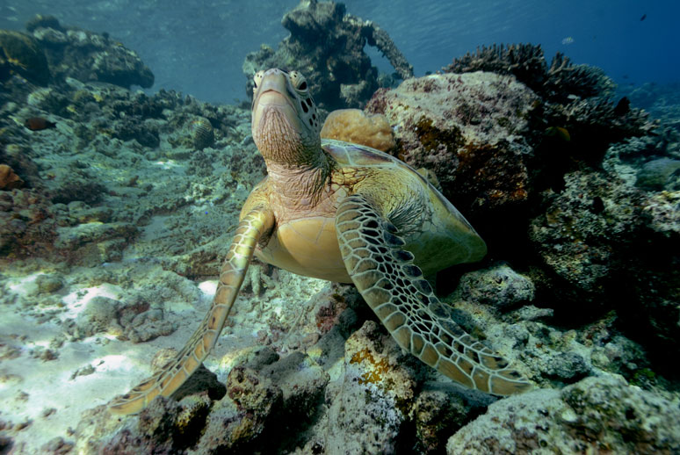
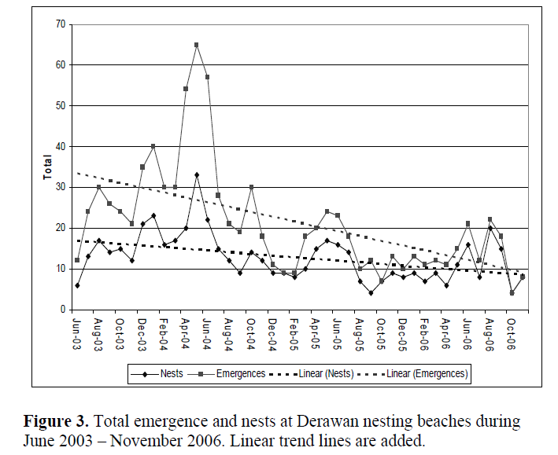
Relevance of Time and Space
- Data collection since 2002
Turtles and nests protected from harvesting since 2005
Local communities challenge impact of protection
Satellite transmitters added
Incidental by-catch data collected
More comprehensive information, need for regional protection
Impact maybe 20-30 years from now

Slide 6

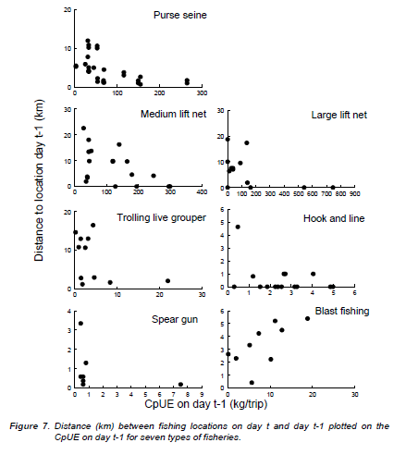
Relevance of Time and Space
- Indonesian CEDRS aggregates data over species and areas
Trends with low variance at national level but low relevance for management at ecological or administrative levels
Most fishers strategize on experience in space and time – type of fishery
Collaborative management requires facts & figures at meaningful levels to support arguments for change

Slide 7
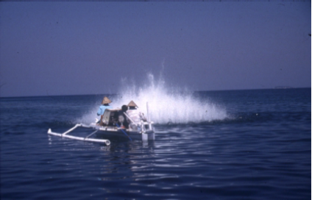
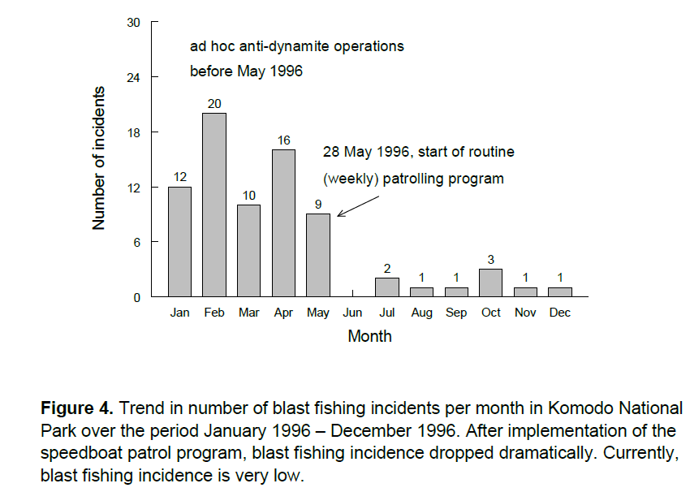
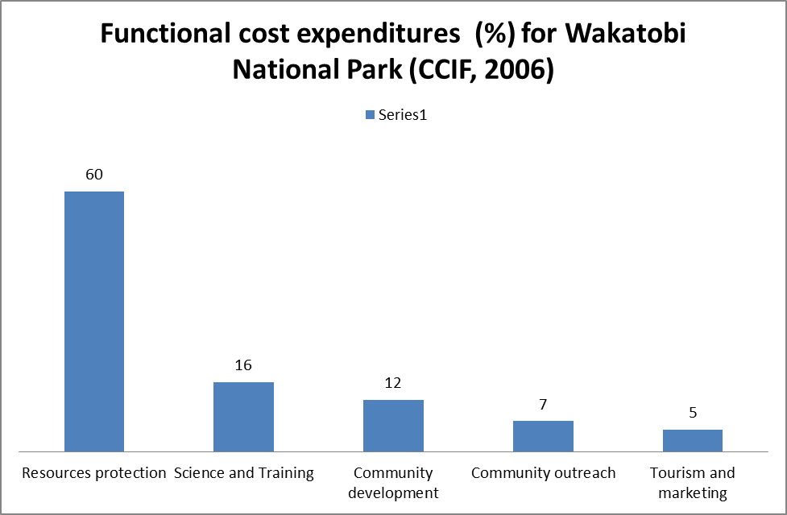
Relevance of logistics and resources
Enforcement surveillance: Komodo (1996) and Wakatobi (2006): bombing reduced
after 2010: Budget for patrol and enforcement reallocated – bombing back in both NPs
Biological and resource use monitoring: occurrence of non-compliance zonation but spawning aggregations relatively protected during peaks spawning
media outcry incidental action but not systematic
Mous ,McCorry & Pet 2007 TNC

Slide 8

Some lessons
Adjust communications
Measure:
  change in threats from human behavior
  change in enabling conditions
Adjust indicators, impact framework

Slide 9
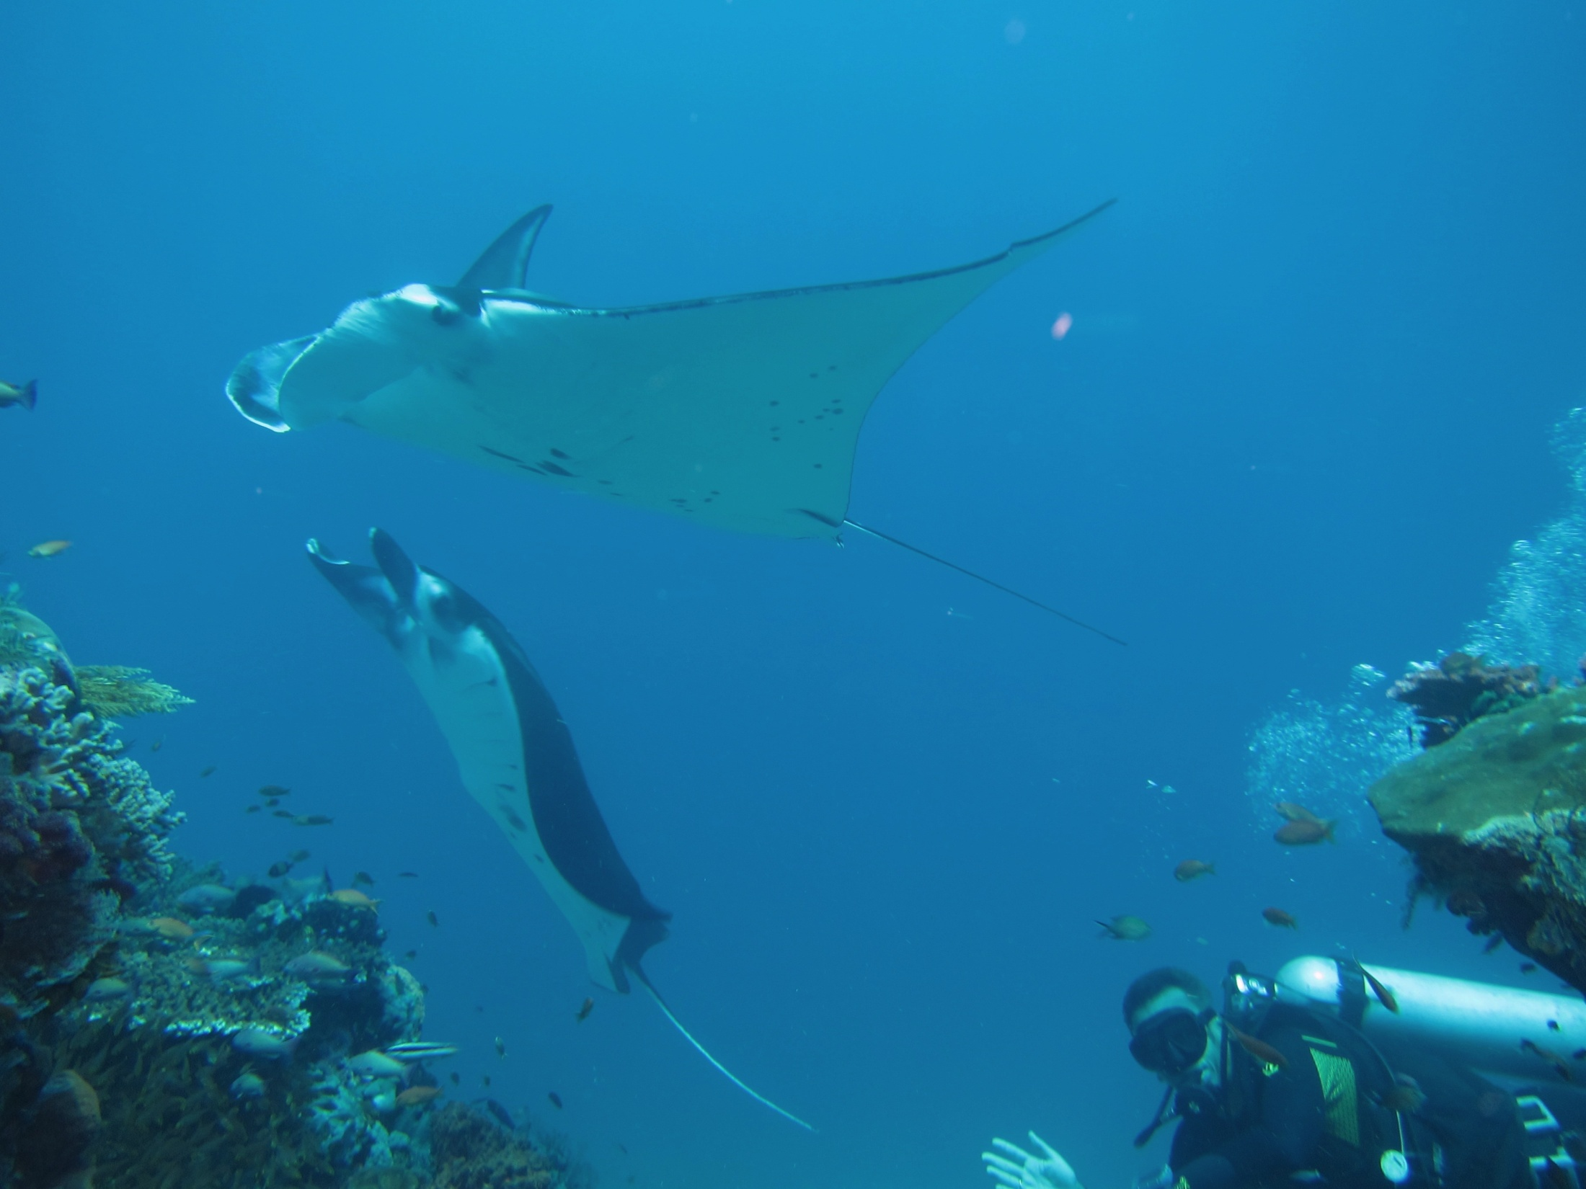
Each level is cumulative – i.e. achieving at one level is assumed to require a high level of achievement in each of the lower levels.
Achievements can be made simultaneously at several levels of impact. It is likely however that higher levels impacts will substantially be built on lower levels.
There is likely to be a “tipping point” before progress can be made at the higher level.
Outcomes at Level 4 must be in terms of real and long-term changes in the environment.
Level 1 – Creating the debate:
Impact Indicator: A positive environment for change is established among a critical mass of key decision-makers and stakeholders.
Level 2 – Influencing opinion:
Impact Indicator: An active and engaged constituency for positive change in policy, practice or procedures is established.
Level 3 – Measurable results
Impact indicator: Changes in the policies, practices and procedures of key institutions, stakeholders or markets.
Level 4 – Sustainable outcomes
Impact indicator: Sustainable changes in the status of biodiversity components (e.g. species recovery, threatening process mitigated successfully).

Slide 10
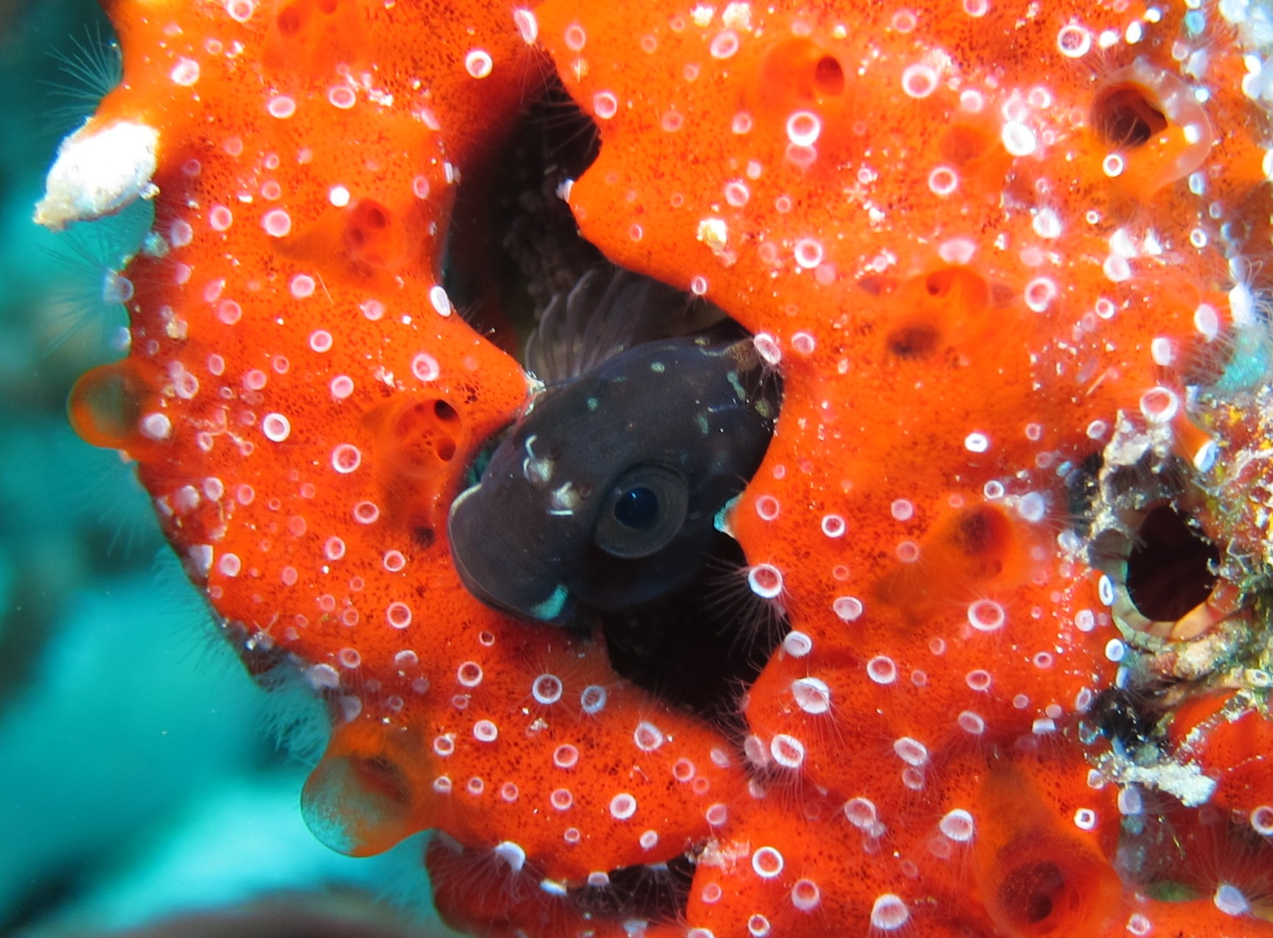
Measuring Framework

Slide 11
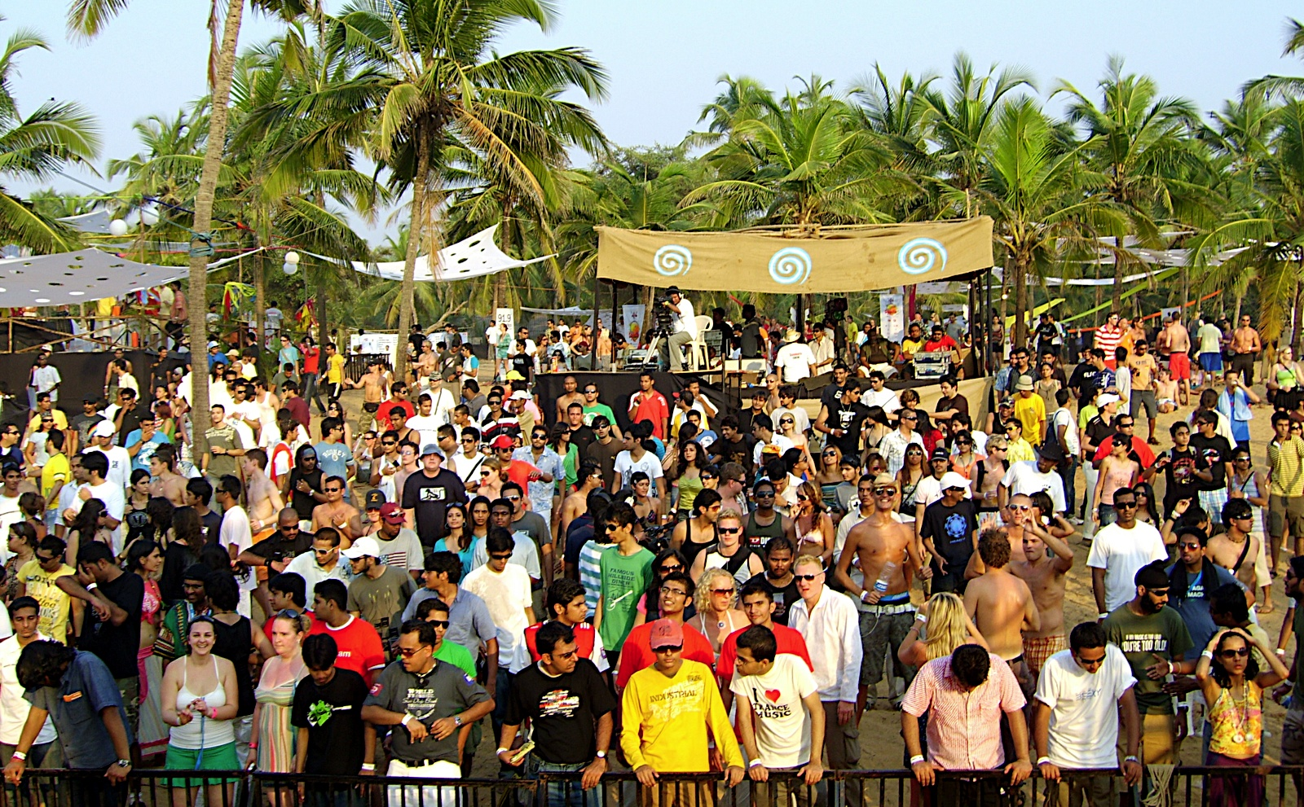
Please help www.panda.org/coraltriangle

